Slide 1
CS1501 Introduction to Blockchain
Fridays 1-1:50PM,
Thornton Hall D115

Slide 2
Roadmap
Getting Up to Speed on Blockchain
Database to Distributed Database
Bitcoin
Blockchain for Money
Incentive Loops
Logistics
Onboarding
Expectations
Opportunities
Before Next Class

Slide 3









Databases

Slide 4
Desirable Properties for Databases
Privacy
Auditability
Permissioned
Permissionless
Cheap Storage/Overhead
Cache
Distributed

Slide 5
Properties of Good Blockchains
Immutability
Backwards Compatibility*
Low latency to finality
Fault Tolerance

Slide 6

Twitter

Slide 7

Gatekeeper

Slide 8
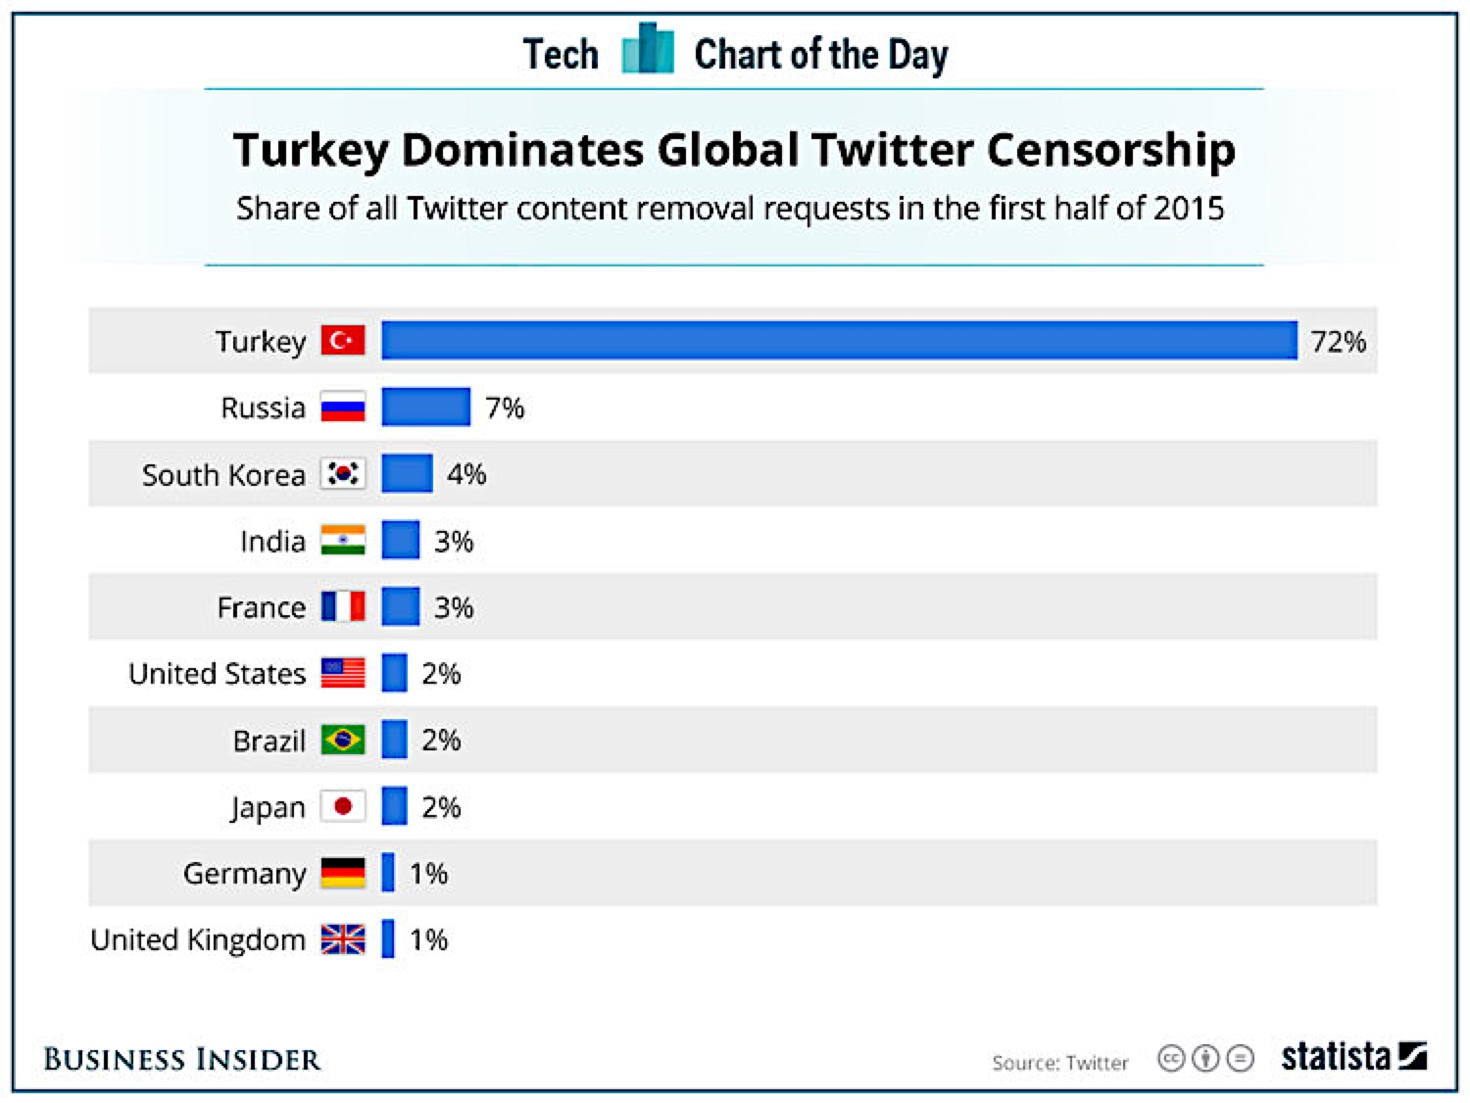

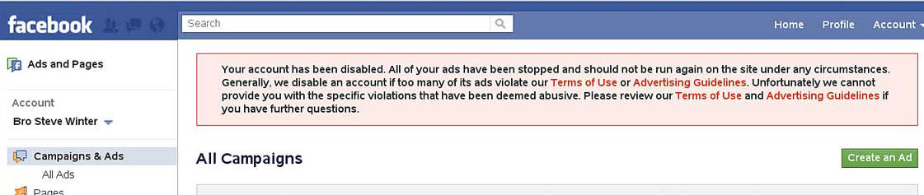

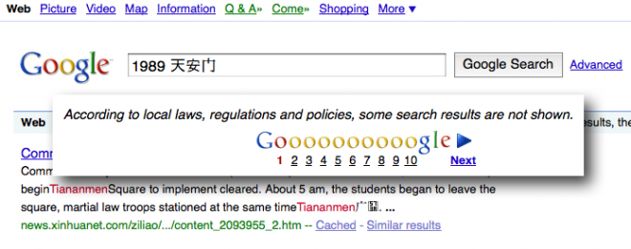
“But we can trust them…”

Slide 9
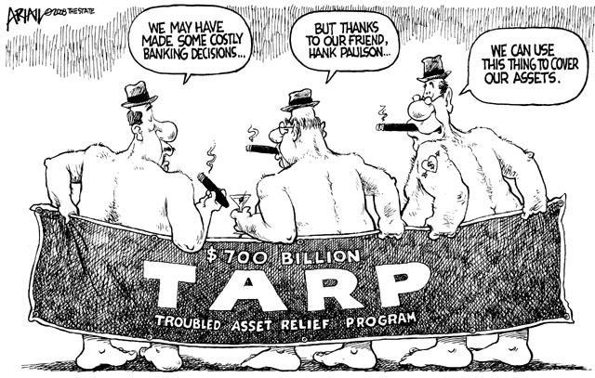
Great Recession
2007-2008 Housing market crashes
Huge government bailouts via TARP
Federal Reserve enacts quantitative easing (targeted helicopter money)

Slide 10
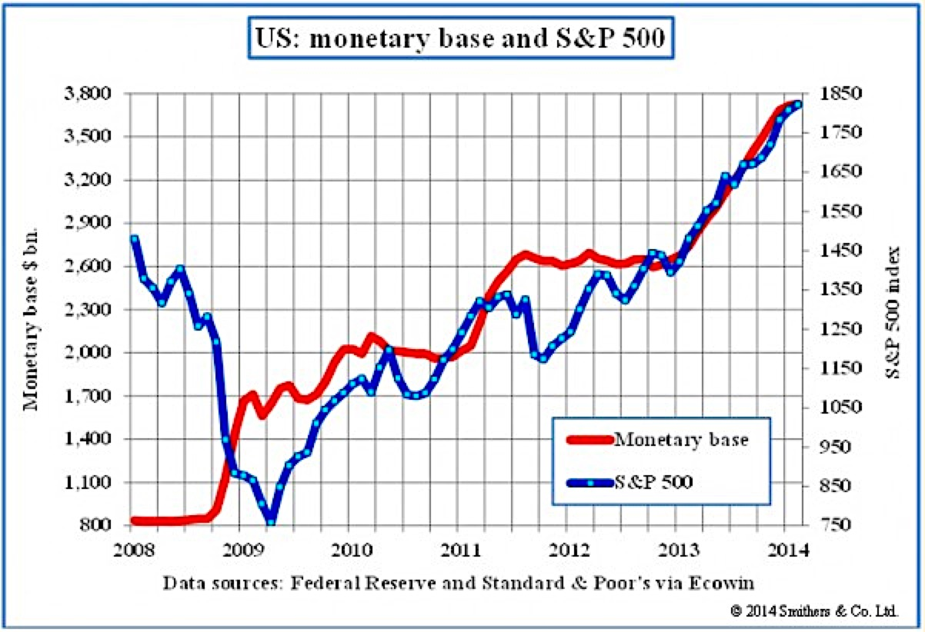
Cantillon Effect
“The first ones to receive the newly created money see their incomes rise, whereas the last ones to receive the newly created money see their purchasing power decline as consumer price inflation comes about.”

Slide 11
F. A. Hayek
“I don’t believe we shall ever have a good money again before we take the thing out of the hands of government. That is, we can’t take them violently our of the hands of government. All we can do is by some sly roundabout way introduce something that they can’t stop.”

Slide 12
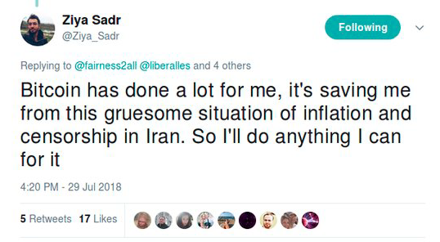
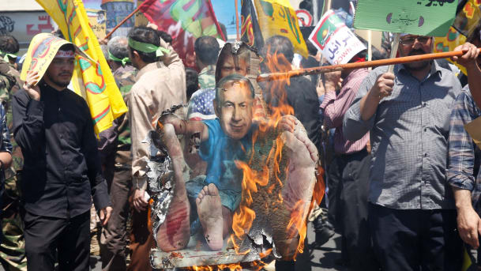
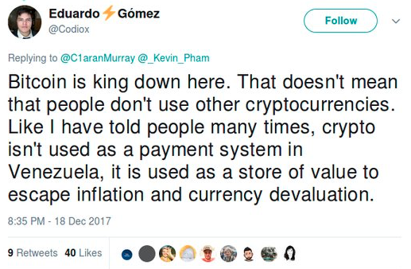
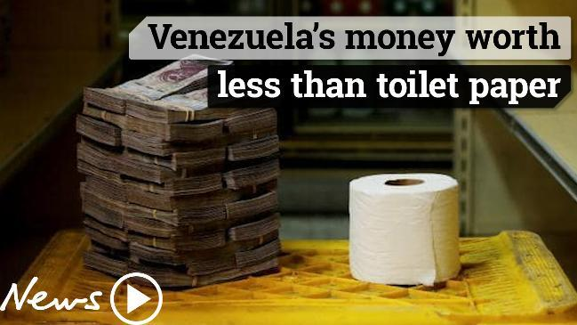

Slide 13
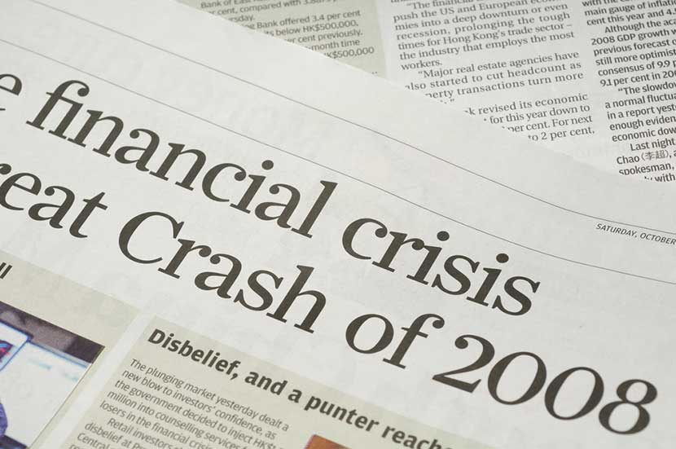
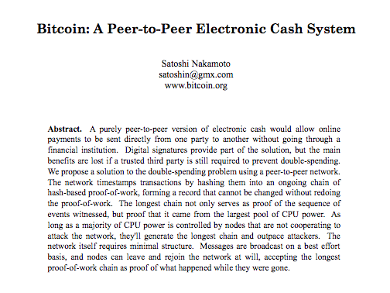
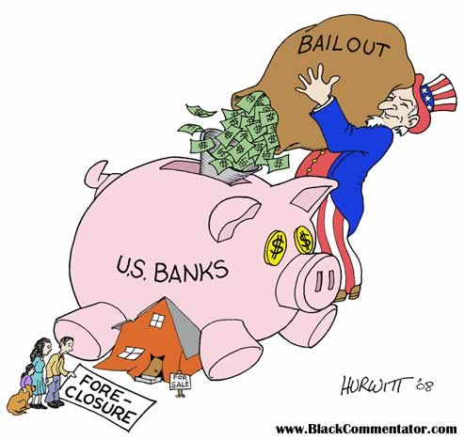
Bitcoin: Paradigm Shift

Slide 14
“Decentralized => Trustless”
Distributed database that isn’t controlled by any single actor/entity
Requirements:
Permissionless
Secure?
Private?
Scalable?

Slide 15

Since then…
Ethereum
ZCash
Layer 2 Scaling
Sharding
Proof of Stake
Lots of open source development and research!

Slide 16
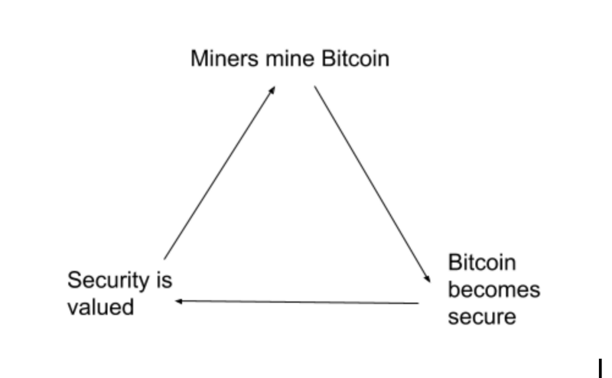
Incentive Management
The best cryptocurrency protocols and applications have robust incentive loops!
BITCOIN

Slide 17
“Blockchain not Cryptocurrency”
Role of cryptocurrency in blockchain design
Attach cost to submission of transactions
Reward miners according to value provided by the network
Create long-term incentives for miners

Slide 18

TODO before Next Class
Read the original Bitcoin whitepaper
Read the recent version of the Ethereum Whitepaper

Slide 19
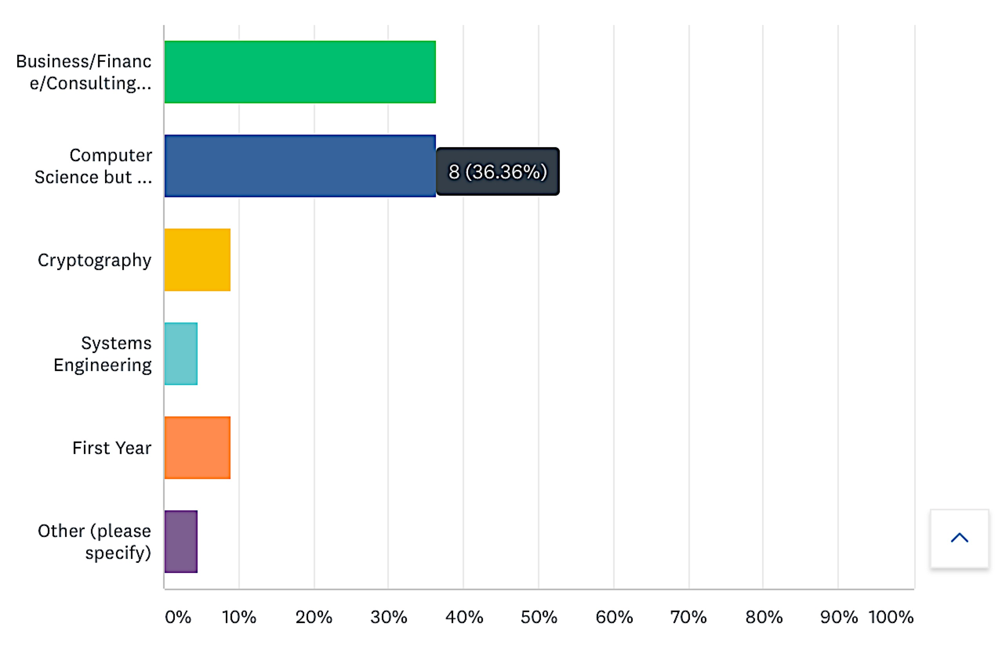
Survey Results

Slide 20
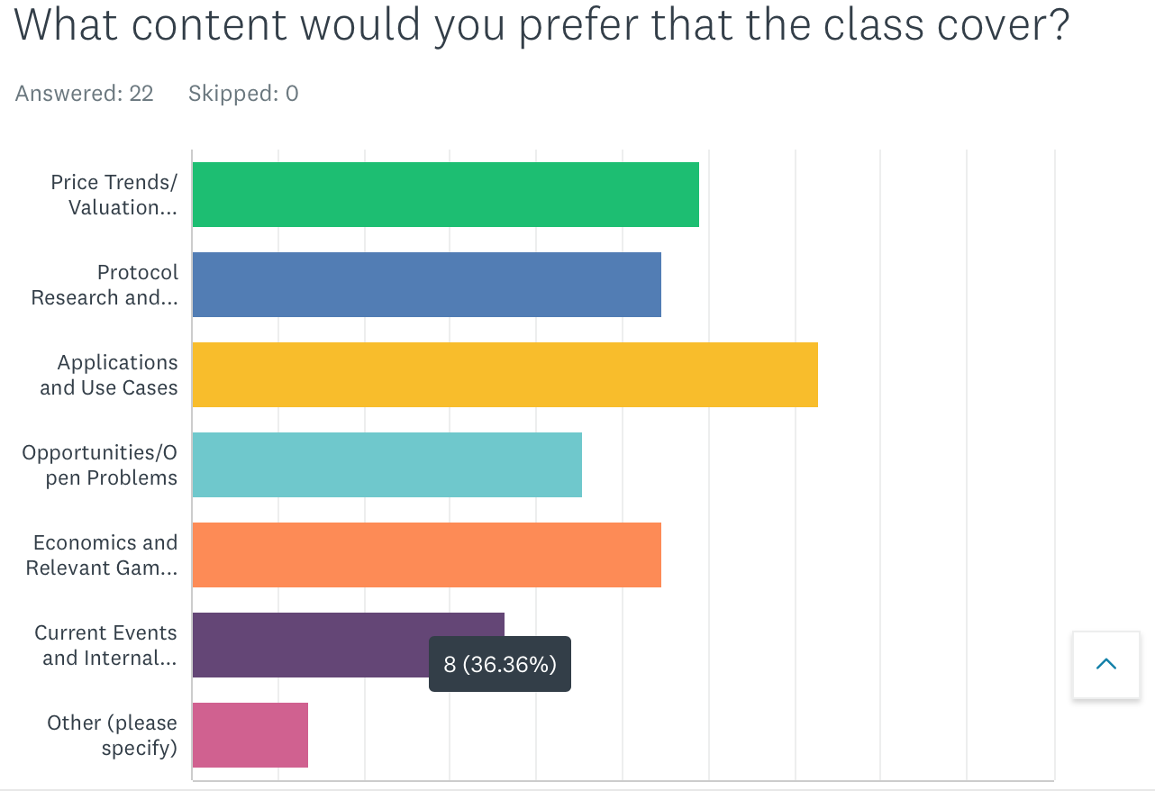
Weak EMH, etc.

Slide 21
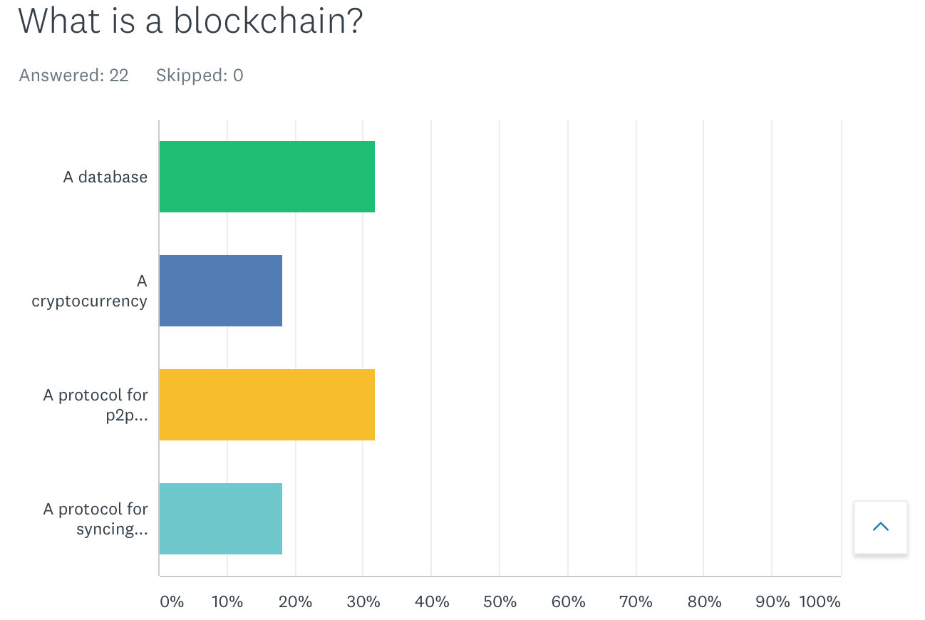

Slide 22
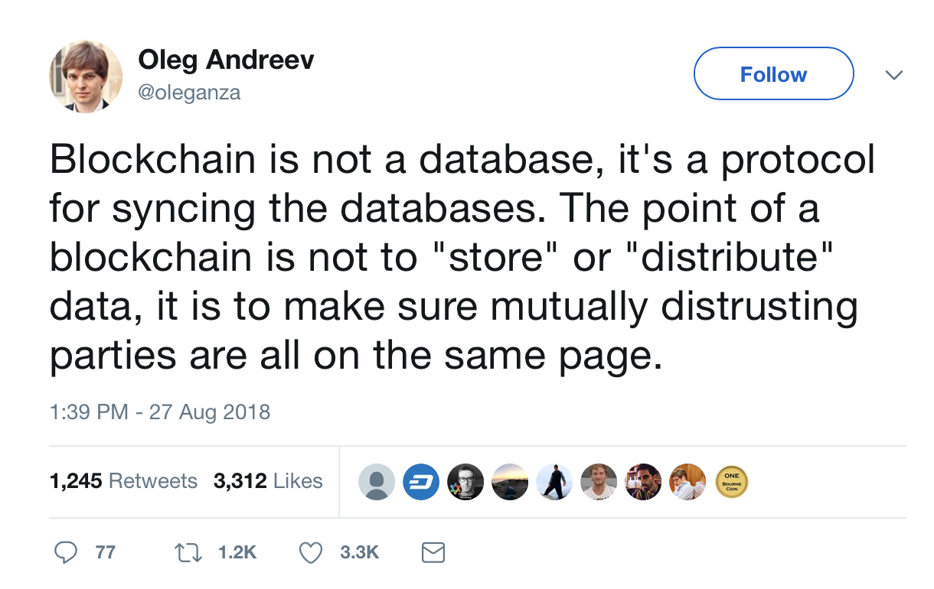

Slide 23
Course Site

Slide 24
Course Goals
Provide a technical introduction to blockchain technology for students of all levels
Explore applications to governance/voting, content curation, and business models
Push ambitious students to learn, build, and launch new projects in this space

Slide 25
Expectations
Every week:
Lecture
Reading List
Quiz
Optional Coding Projects/Curriculum
Discussion forum to coordinate side projects (Telegram)

Slide 26
Biases
Ethereum
Zcash
State Channel Research by Counterfactual, L4
Plasma Research by OmiseGo
Governance by Aragon, Ryhope Network, and Harbour Project
Mimblewimble/Grin
Rust (the programming language)

Slide 27
Options
Discuss my projects?
QA:
What courses/resources would be helpful for understanding cryptography behind blockchains?
How can I get the most out of the class?
What should I do to break into this space?

Slide 28


Decentralized Blockchain Library Powered by Cryptoeconomics

Slide 29
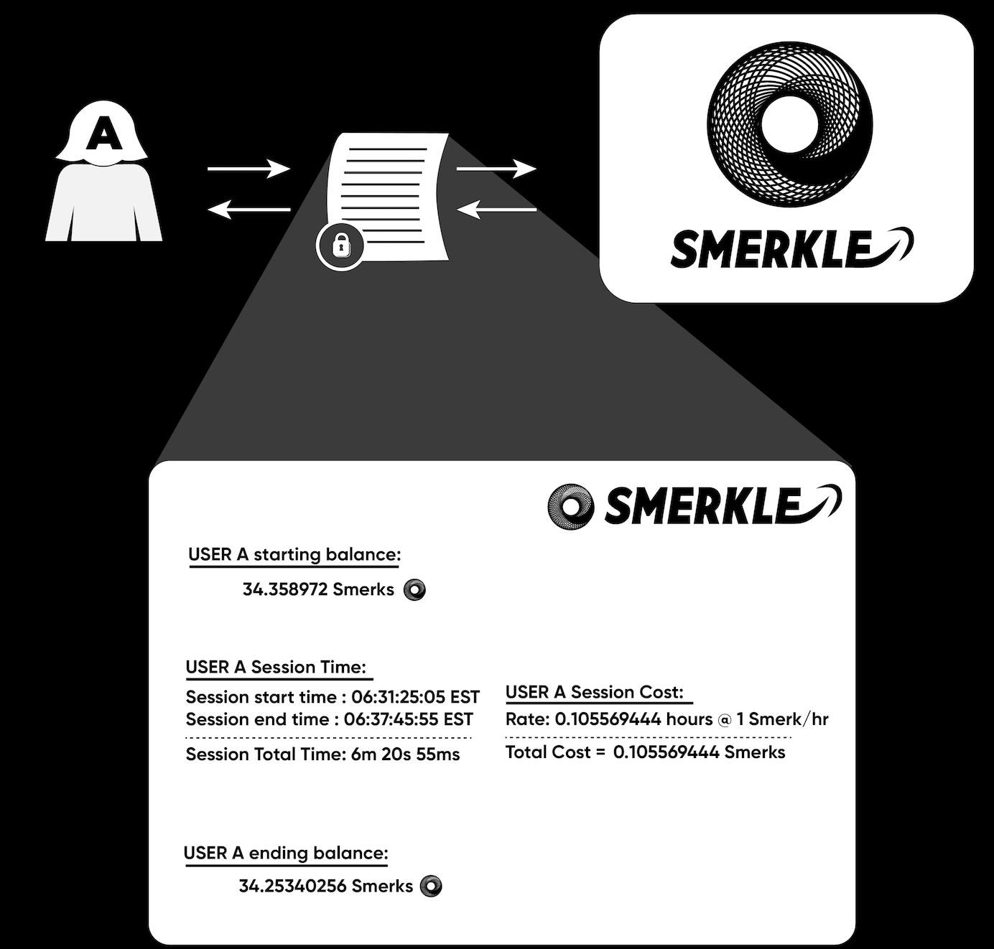
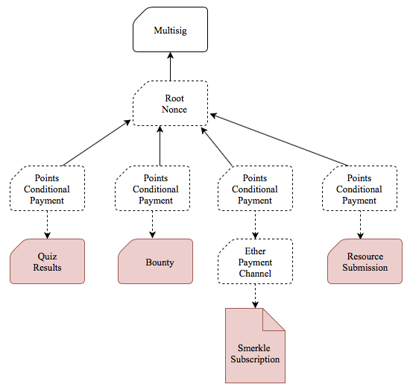
Micropayment Subscription Model
State Channels provide cheap, instant finality for transactions.
Using micropayment contracts, users pay for services as they use them.
This design encourages a competitive market in which users can switch among service providers based on changes in quality/price.

Slide 30
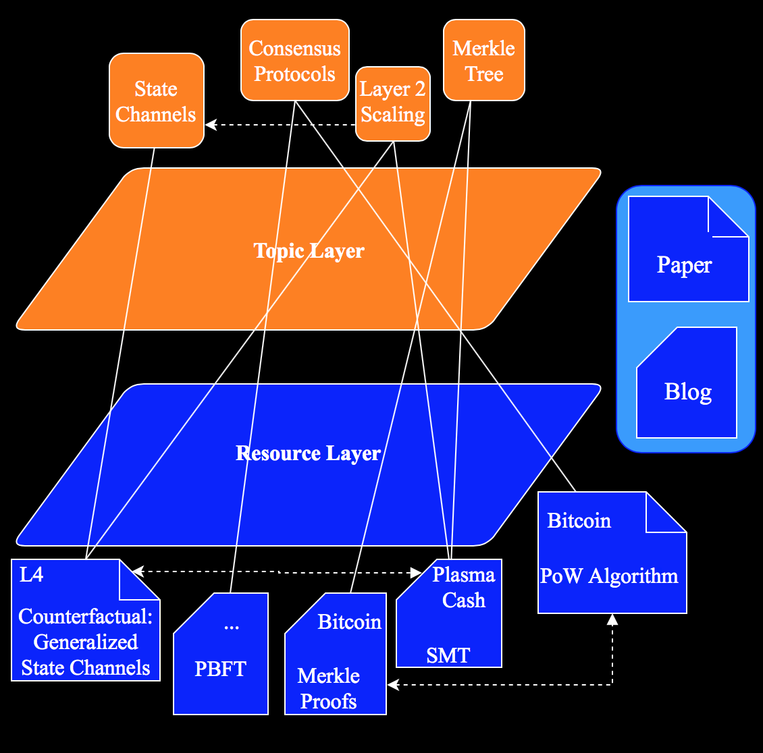
Organization of the Knowledge Graph
The surjective mapping from Topics to Resources defines the Knowledge Graph (this mapping requires that every resource has ≥1 topic)

Slide 31
A6 Staking
Invest in Web3 by staking/mining on Ethereum, Tendermint/Cosmos, Lightning, Handshake, Polkadot, Tezos
Competition: Cryptium Labs, My Tezos Baker, HappyTezos, Figment Networks, Staking Facilities, Chorus One
Twitter: @A6Staking

Slide 32
DCentral Bank
w/ Fed Challenge
Professor Carter Doyle
“New Taylor Rule”

Slide 33
DONE

Slide 34
Belief
It is my belief that we can measure the efficiency of the decentralized communities by how fast they can incorporate progress in research into the design/implementation of their blockchain protocols; this requires fast protocol governance…need to communicate that different blockchains offer different value propositions (Bitcoin should prioritize backwards compatibility according to most)

Slide 35
There will probably not be a winner take all system
First go over scalability trilemma and emphasize decentralization – scalability tradeoff
Go Over Roles
Bitcoin for money, store of value; backwards compatibilit; immutability
Ethereum for dapps
Dfinity: scalable computation
EOS for federated decentralization
https://multicoin.capital/2018/04/24/eos-analysis-and-valuation/

